Slide 1
CSS342 Data Structures, Algorithms, and Discrete Mathematics (I)

Slide 2
Binary Search Tree
A Binary Search Tree (BST) is a tree in which all the nodes follow the below-mentioned properties:
The left sub-tree of a node has a key less than or equal to its parent node's key.
The right sub-tree of a node has a key greater than to its parent node's key.

Slide 3
Exercise
Is this a binary search tree?
8
3
10
14
1
6
4
7

Slide 4
Exercise
Is this a binary search tree?
8
3
10
11
14
1
6
4
7

Slide 5
Exercise
Is this a binary search tree?
8
3
1
6
4
7

Slide 6
Exercise
Is this a binary search tree?
2
3
5
7
6
9

Slide 7
Binary Tree Definition
9
9
Parent
12
3
12
1
5
Child
5
10
10
14
Parent
7
12
18
7
Child

Slide 8
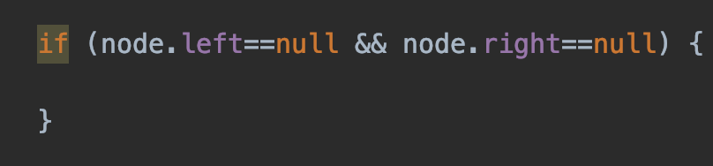
Binary Tree Definition
Root
9
9
9
3
12
1
5
1
5
10
14
7
12
12
18
7
18
Leaf : node without any children node

Slide 9
Tree Node
Implementation
Data storage:
Array
List
3
1
5
7
Left
Right
Next

Slide 10
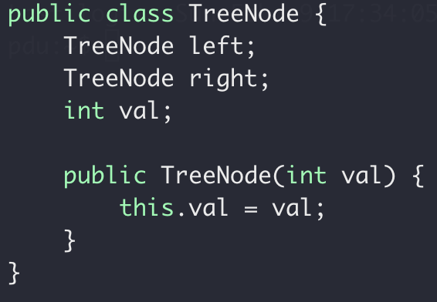
Tree Node
Implementation
Data storage:
Array
List
TreeNode
Left
Right

Slide 11
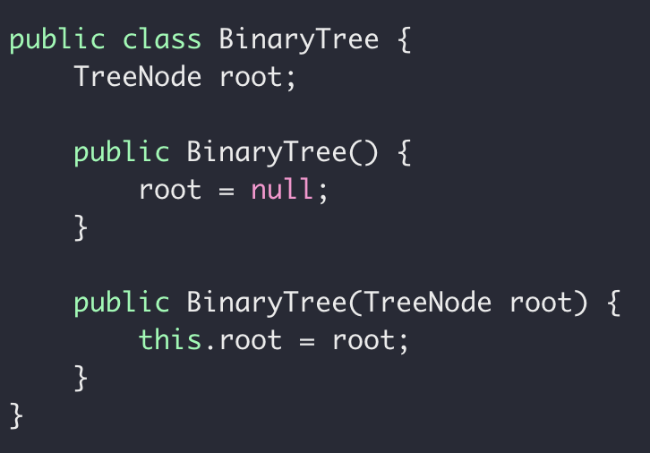
Tree ADT
Implementation
Data storage:
Array
List

Slide 12
Binary Tree Traversal
Pre-order: root, left, right
3
1
1
5
2
7
2
7
8
1, 2, 7
3, 1, 2, 7, 5, 8

Slide 13
Exercise
What’s the pre-order traversal of this tree?
8
3
10
9
14
1
6
4
7
Binary Search Tree

Slide 14
Code it up!
preorder: Root, Left, Right
Recursion
Middle node value
preorder(left subtree)
Preorder(right subtree)
Subproblem?
Stopping condition?
Node == null

Slide 15
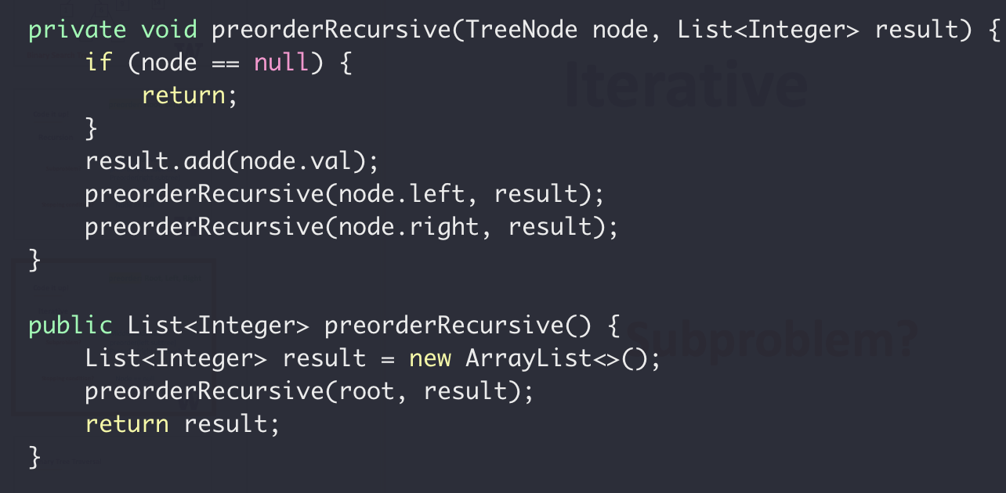
preorder: Root, Left, Right
Recursion

Slide 16
preorder: Root, Left, Right
Iterative
(without recursion)
3
2
4
Result (List):
3
2
4
Stack:
4
2

Slide 17
preorder: Root, Left, Right
Iterative
(without recursion)
While stack not empty {
3
Pop a node from Stack
Add middle node to result list
2
4
Push right node to Stack if any
Push left node to Stack if any
}

Slide 18
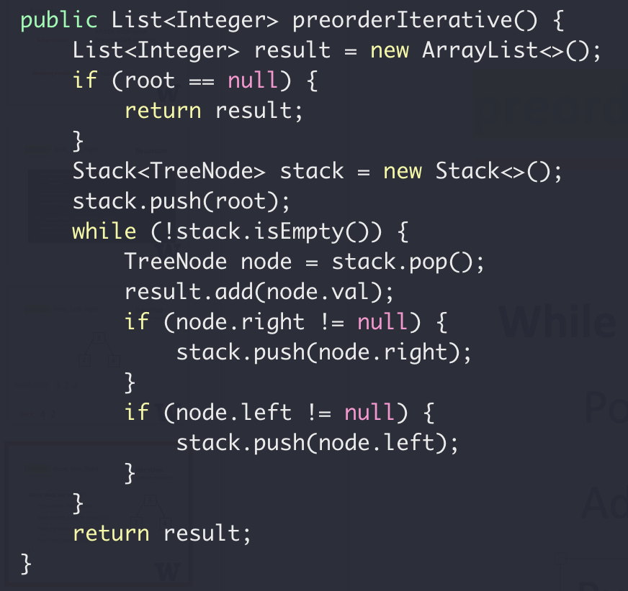
preorder: Root, Left, Right
Iterative
(without recursion)
While stack not empty {
Pop a node from Stack
Add middle node to result list
Push right node to Stack if any
Push left node to Stack if any
}

Slide 19
Binary Tree Traversal
In-order: left, root, right
3
1
1
5
2
7
2
7
8
2, 1, 7
2, 1, 7, 3, 8, 5

Slide 20
Exercise
What’s the inorder traversal of this tree?
8
3
10
2
14
1
6
4
7
In: 1, 3, 4, 7, 6, 8, 2, 10, 14
In: 1, 3, 4, 6, 7, 8, 2, 10, 14

Slide 21
Code it up!
inorder: Left, Root, Right
Recursion
Inorder(left subtree)
Middle node value
Inorder(right subtree)
Subproblem?
Stopping condition?
Node == null

Slide 22
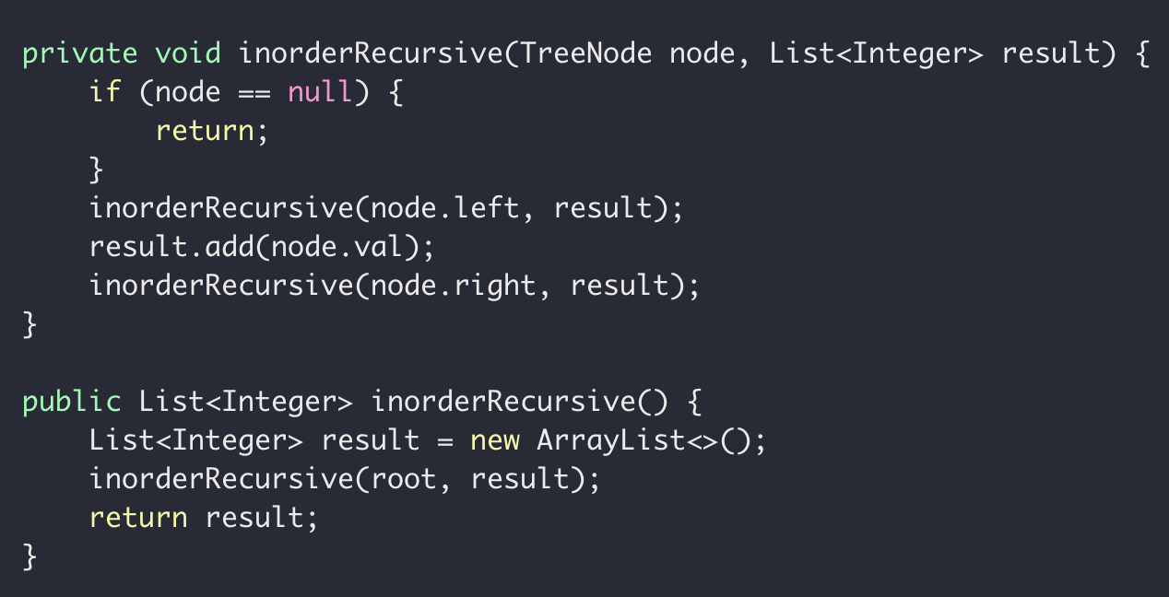
inorder: Left, Root, Right
Recursion

Slide 23
Binary Tree Traversal
Post-order: left, right, root
3
1
1
5
2
7
2
7
8
2, 7, 1
2, 7, 1, 8, 5, 3

Slide 24
Exercise
What’s the postorder traversal of this tree?
8
3
10
2
14
1
6
4
7

Slide 25
Code it up!
postorder: Left, Right, Root
Recursion
Inorder(left subtree)
Inorder(right subtree)
Middle node value
Subproblem?
Stopping condition?
Node == null

Slide 26
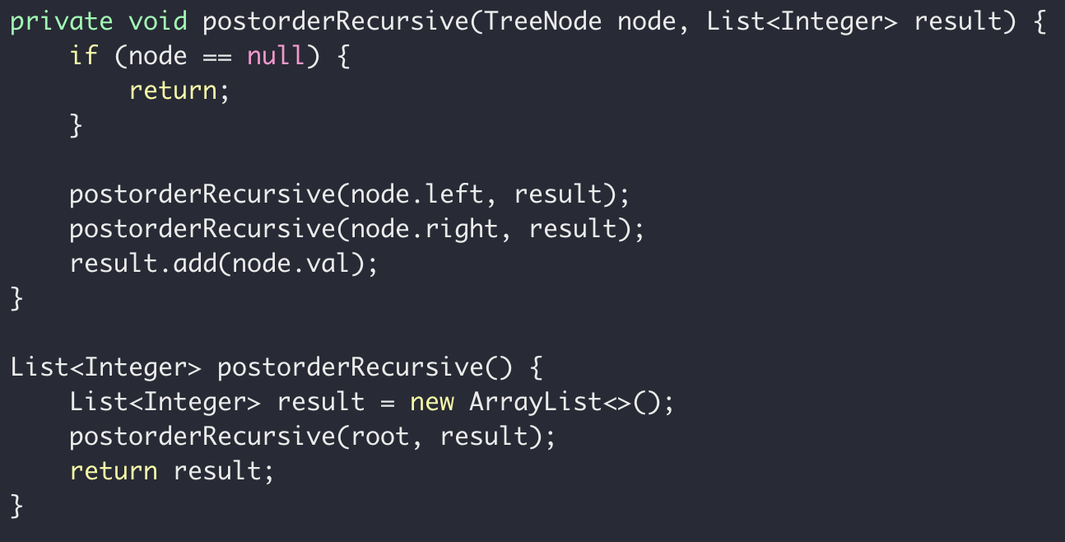
postorder: Root, Left, Right
Recursion

Slide 27
Recursion with Trees
8
3
10
2
14
1
6
4
7

Slide 28
Binary Tree Definition
3
1
5
7
Height of a tree:
Number of nodes
on the longest path
from root to leaf
5
Height = 4
3
3
3
9
1
5
1
1
5
7
Height = 3
Height = 1
Height = 2
Height = 2

Slide 29


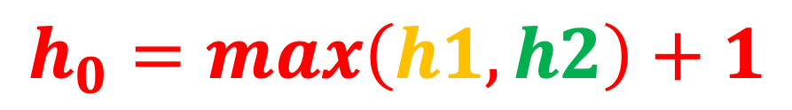


Height of a tree
$$h_{0}$$
$$h_{1}$$
$$h_{2}$$
$$h_{0}= ?$$
$$h_{0}=max\left(h1, h2\right)+1$$

Slide 30
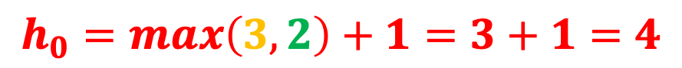

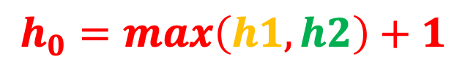





$$h_{0}=max\left(h1, h2\right)+1$$
$$h_{0}=max\left(3, 2\right)+1=3+1=4$$
$$h_{0}$$
$$4$$
8
$$h_{2}$$
$$h_{1}$$
$$2$$
$$3$$
3
10
2
14
1
6
4
7

Slide 31
Code it up!
Height of a tree
Recursion
height(left subtree)
height(right subtree)
Subproblem?
Stopping condition?
Node == null

Slide 32
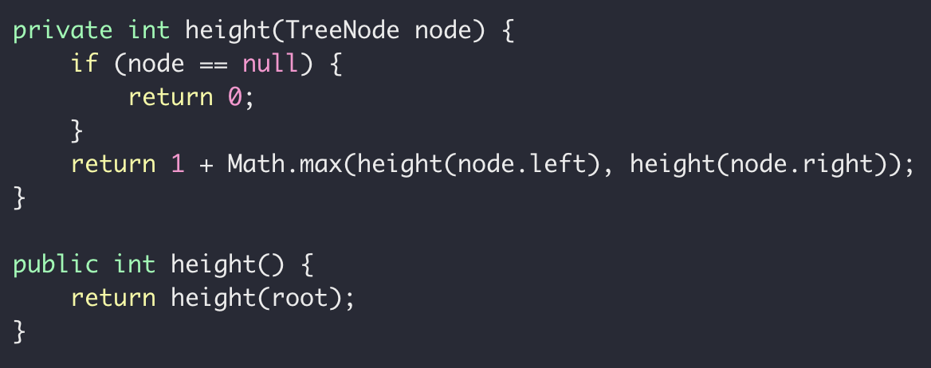
Code it up!
Height of a tree

Slide 33
Exercise
Lowest Common Ancestor of two given nodes
Assumption: Binary Search Tree, v1, v2 always exists in the tree
r = LCA(v1, v2)
LCA(1, 4)
LCA(4, 9)
6
LCA(1, 3)
LCA(4, 7)
LCA(3, 1)
3
9
LCA(3, 9)
LCA(1, 6)
1
4
7

Slide 34
Height of a tree
6
r
LCA(3, 9)
LCA(1, 4)
3
9
v1
v1
v1
v1
LCA(10, 15)

Slide 35
Code it up!
Recursion
LCA(left subtree), or
LCA(right subtree)
Subproblem?
Stopping condition?
Node == null, or
Node.val is the LCA

Slide 36
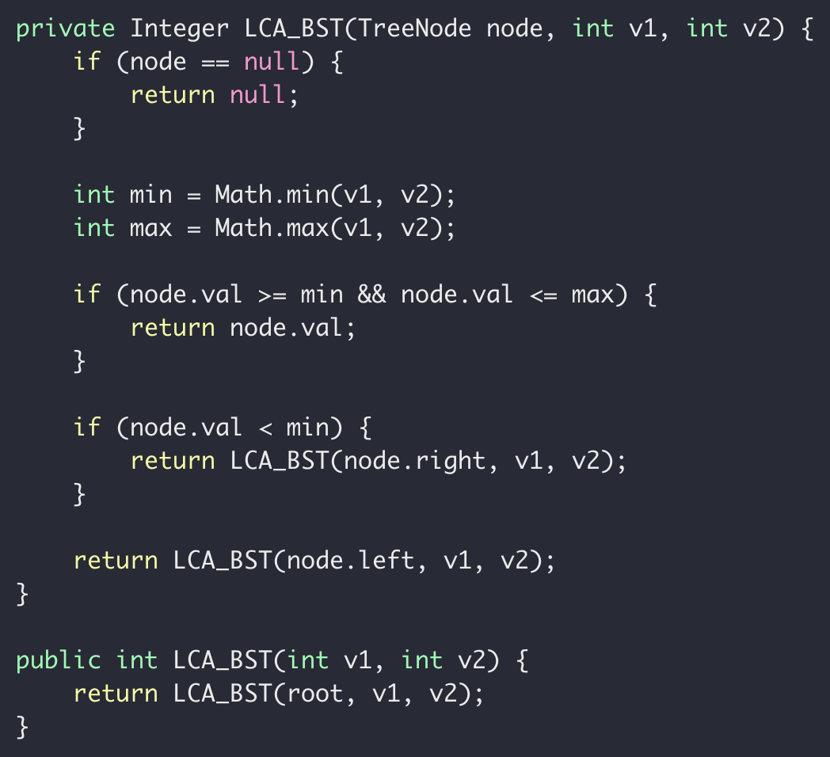
Code it up!
What if it’s not a BST?

Slide 37
Why are we talking about binary trees again?

Slide 38
A search problem
Target: 14
18
12
1
7
5
10
3
12
9
14
14
0
1
2
3
4
5
6
7
8
9

Slide 39

A search problem
Possible Solutions:
Linear search in a random array
Slow insertion, slow search
Sort array and then binary search
Slow insertion, slow search
Use binary search tree
fast insertion, fast search

Slide 40
A search problem
Linear search in a random array
Sort array and then binary search
Use binary search tree
search
Size n

Slide 41
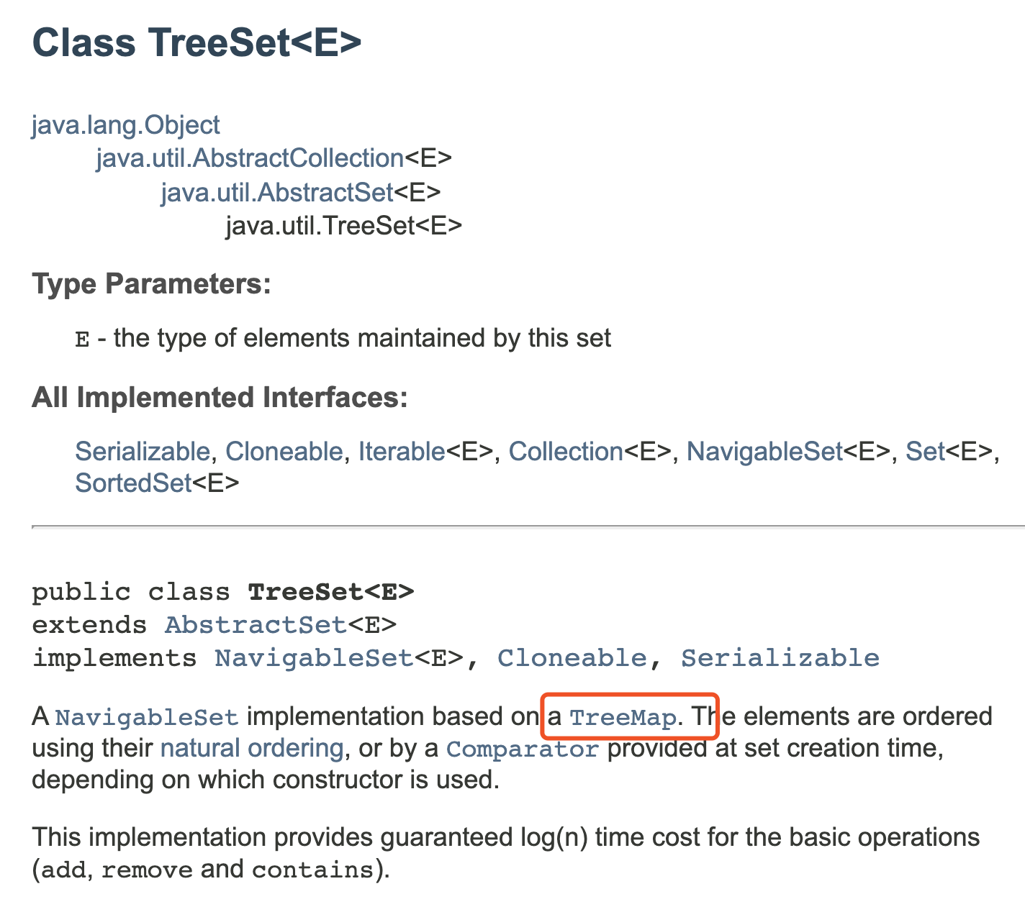
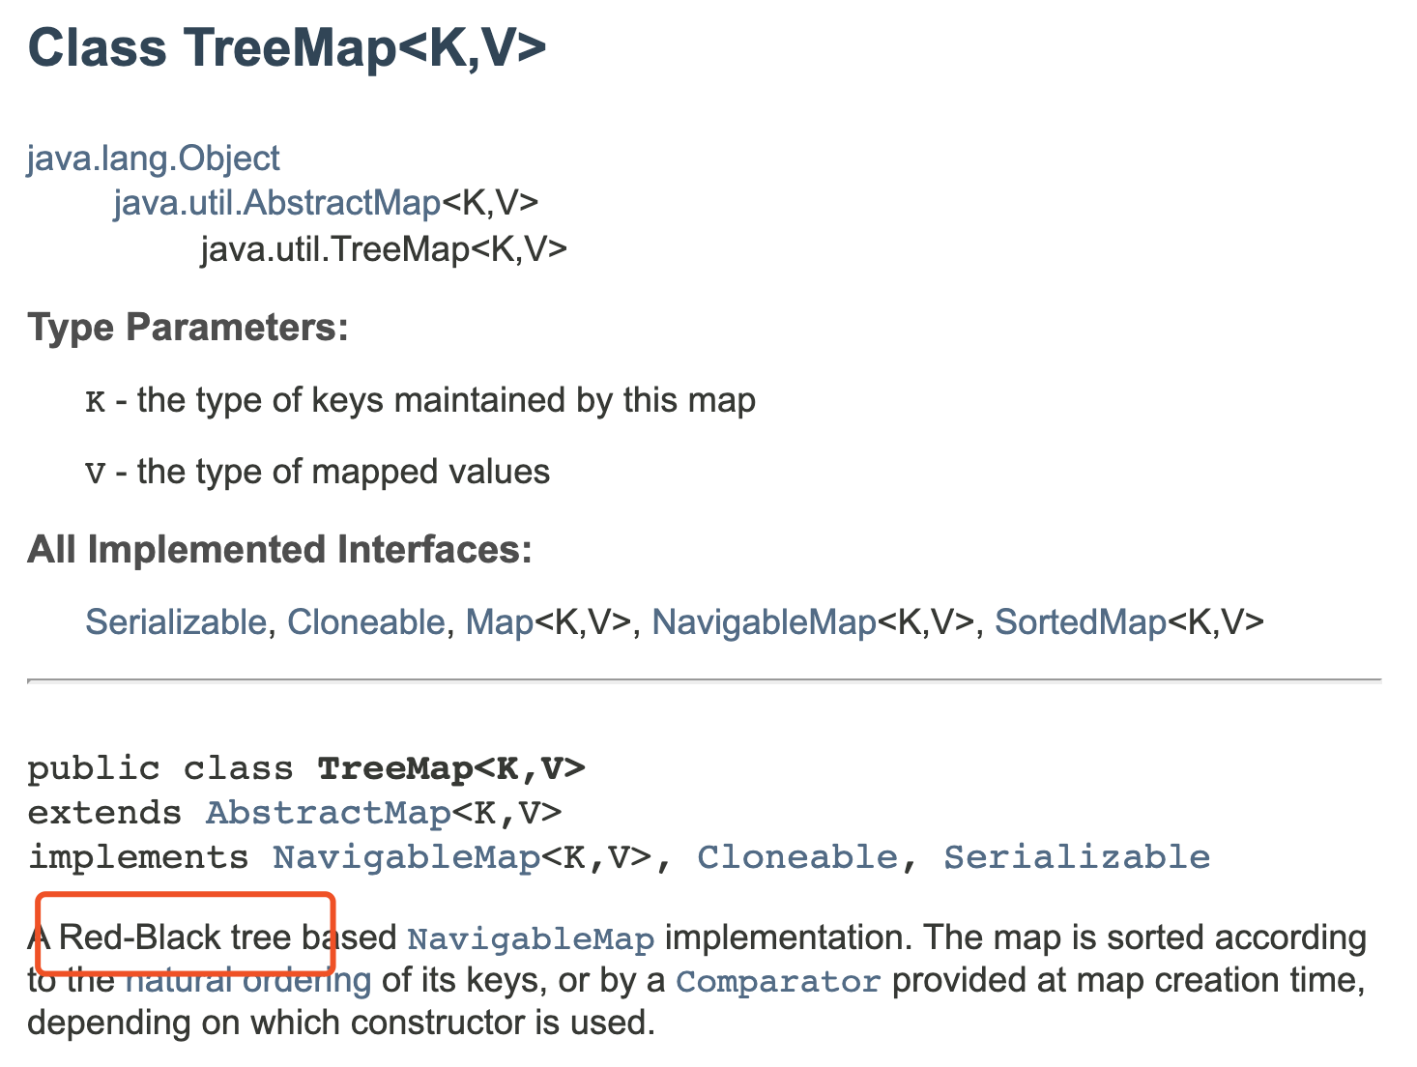
A search problem
Linear search in a random array
Sort array and then binary search
Use binary search tree

Slide 42
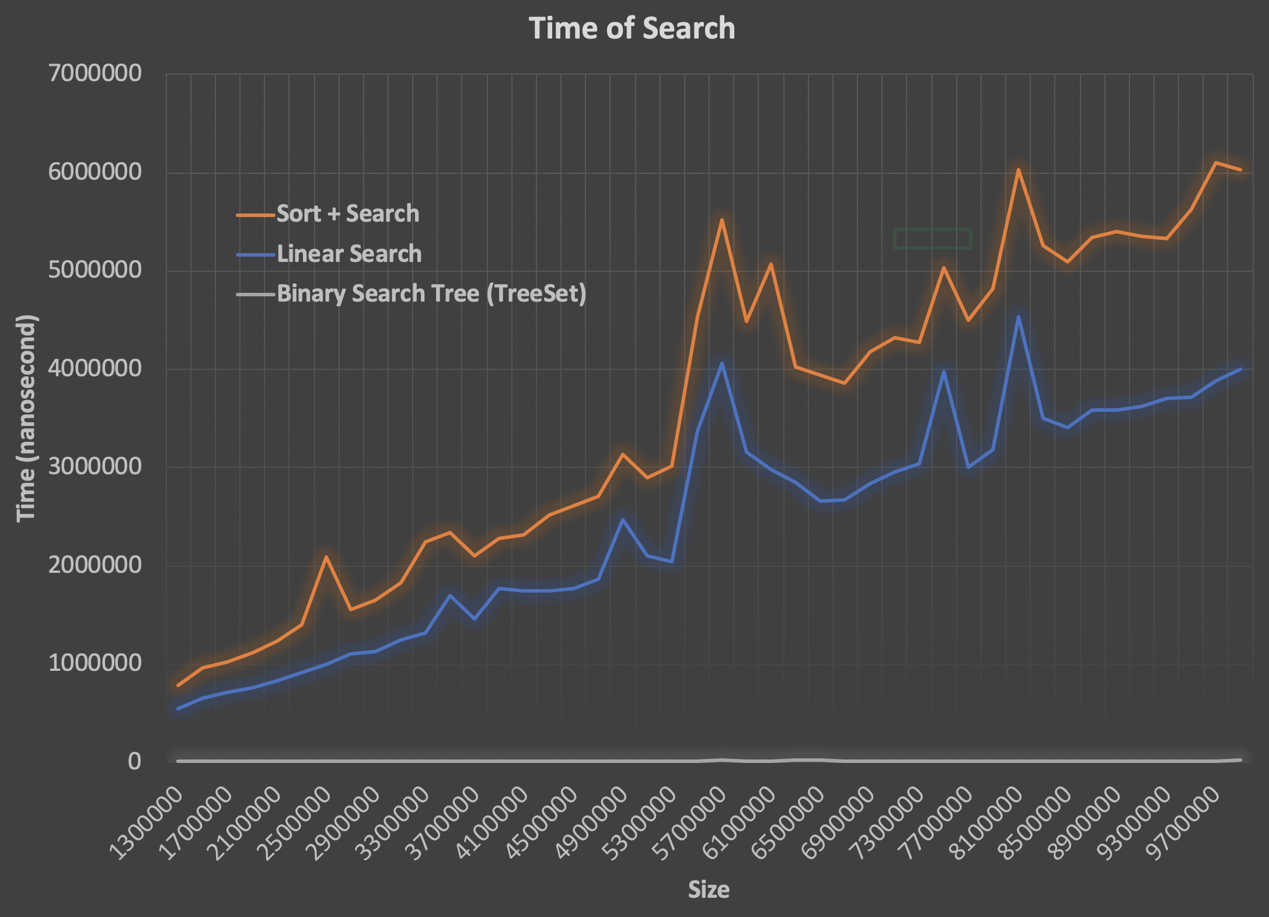
A search problem

Slide 43



A search problem
Possible Solutions:
Linear search in a random array
Slow insertion, slow search
Sort array and then binary search
Slow insertion, slow search
Use binary search tree
fast insertion, fast search

